Slide 1


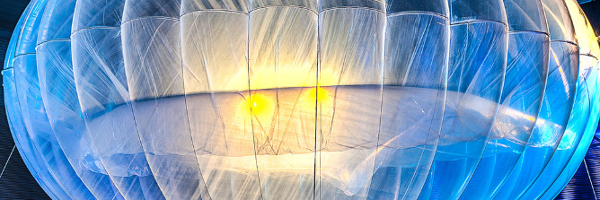
Loon Data Center and Its Security implementations.
Vishal singh (18201687)
Kalyan chakravarthi (19106513)
bino Varghese (18141633)

Slide 2
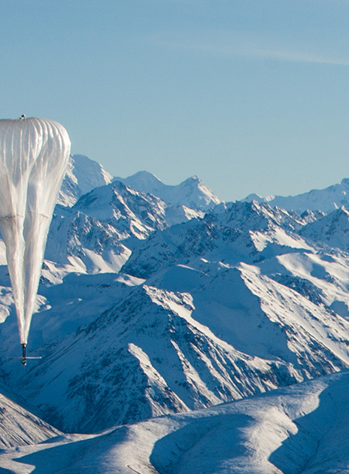
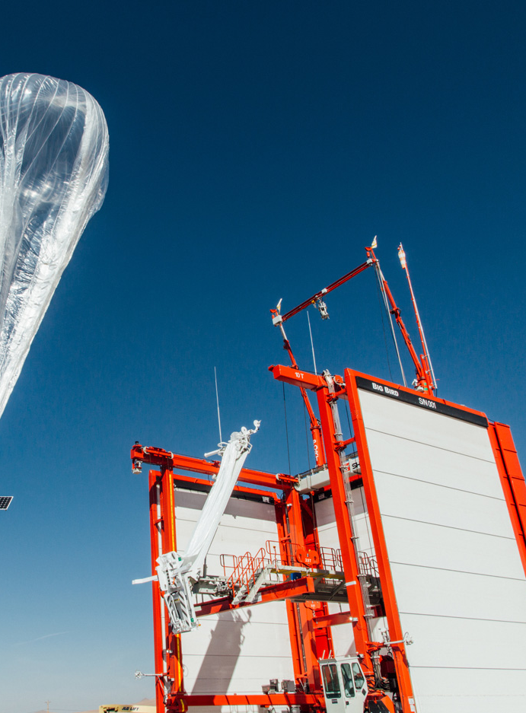
Introduction.
Source of our idea.
What is loon data center.
How it works.

Slide 3
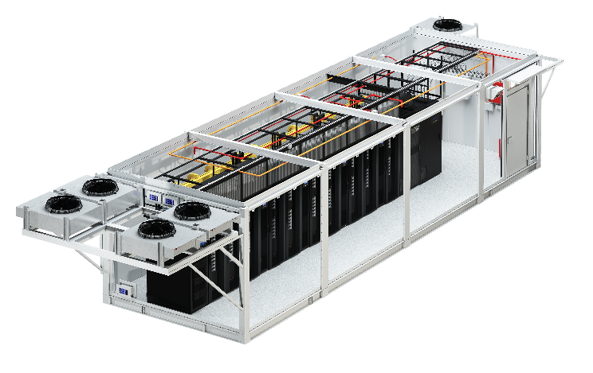
Data center Platform.
We will have a edge data center with a couple of racks.
The data center cabinet will be constructed using Allite super magnesium.
We use SSD to reduce server weight and ssd emits less heat than hard drives.

Slide 4
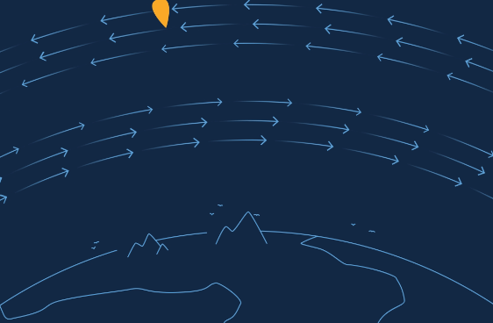
Navigation of Loon.
It will be placed in the stratosphere layer.
It flows with the wind currents.
Increase air density to change the altitudes of the loon.

Slide 5
Ground base station.
The loon will be controlled and monitored by an operators team.
The communication systems will be installed here.
The exact location of the loon is only known to the operators.
They are in-charge of navigating the loon.

Slide 6
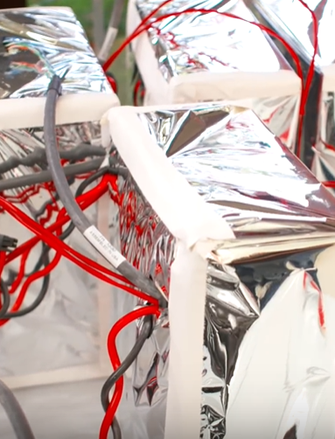
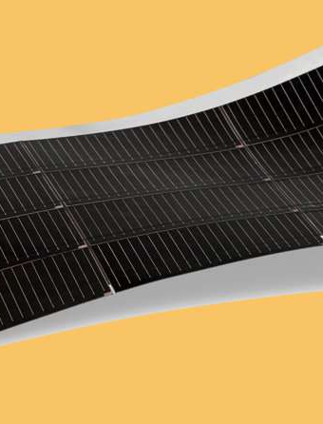
Power and batteries.
Loon will be powered by the Gallium Arsenide solar panels attached with the loon.
The energy is stored in Relion’s lithium iron phosphate batteries.
The batteries can store energy to power the data center during night-time.
The batteries are covered with space blanket to protect itself.

Slide 7
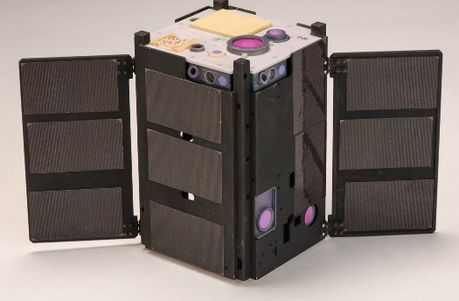
Network connectivity with the loon.
It will be connected using laser communications.
Radio communications will also be used as backup communication.
Laser systems can deliver high data transfer rates of up to 1Gbps over a distance of 60kms.
Having multiple base stations can help us to cover more distance.

Slide 8
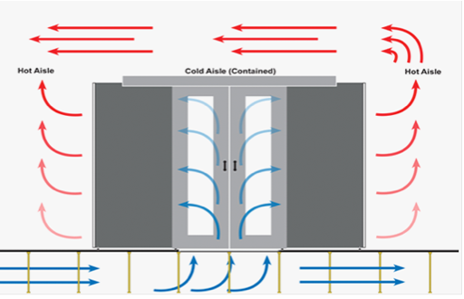
Cooling and heating.
Free cooling system.
We use natural cold air in stratosphere to cool the data center.
There are fans installed to inhale and exhale cold and hot air from the data center.
We use hot air to heat the batteries so that it doesn’t get frozen.

Slide 9
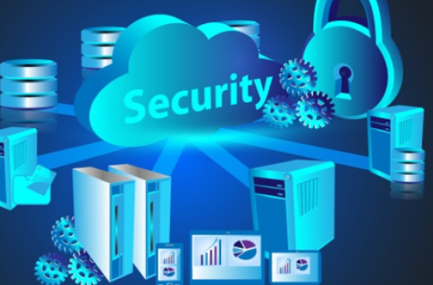
Security implementations for loon data center.
We define 5 levels of security.
Geographical security.
Physical security.
Data security.
Operational security.
Network security.

Slide 10
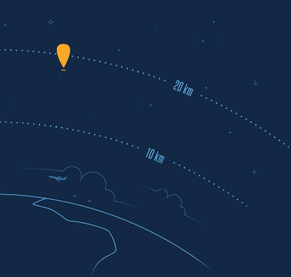
Geographical security.
This type of data center is always safe from natural disasters.
No direct human interaction.

Slide 11
Physical security.
Collision avoidance system.
Fire protection.
Balloon exploding.
Loss of power supply.
CCTV on the loon and inside data center cabinet.

Slide 12
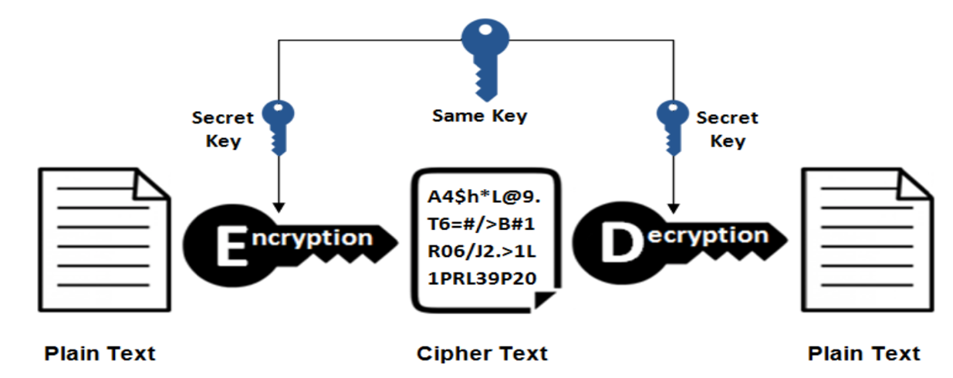
Data security.
Data Encryption.
Multi-layer Encryption.
Software security.
Backups of backups.
Integrity
Authentication.
Availability

Slide 13

Operational security.
Disaster recovery.
Ground base station security.
CCTV surveillance.
Two Factor authentication.
Limited user access.

Slide 14
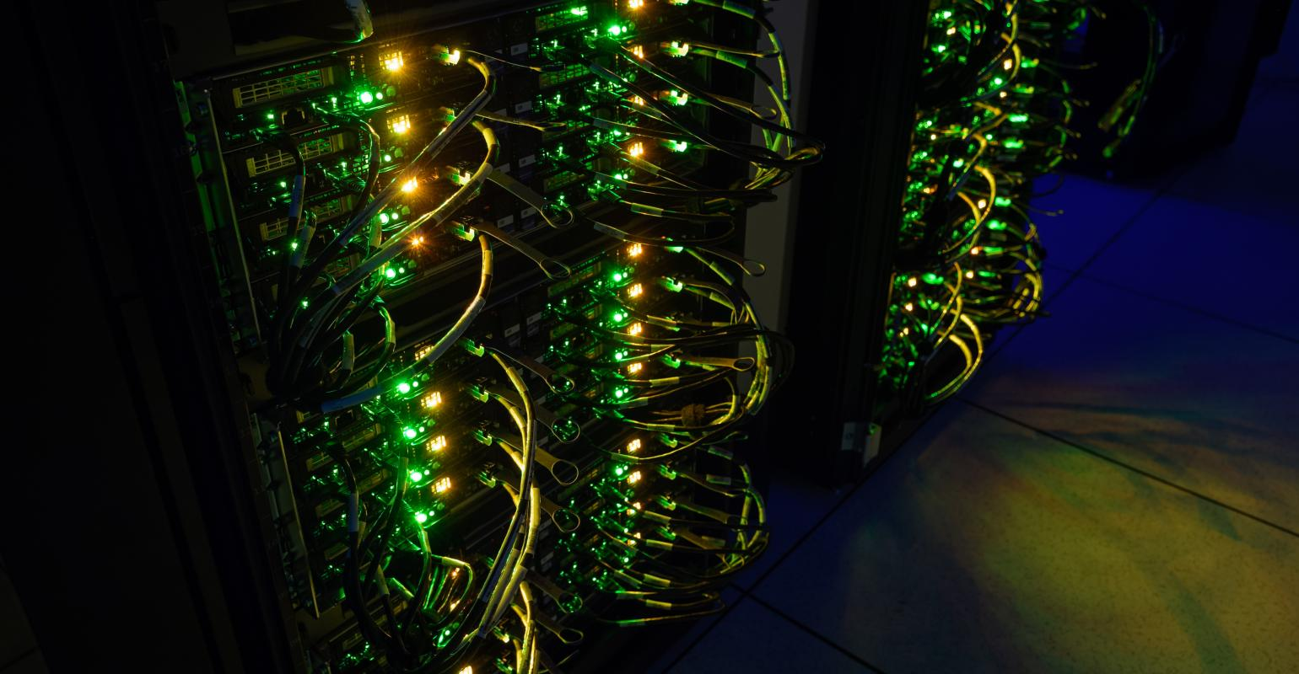
Network security.
Firewall Protection.
IP spoofing.
Man in the middle attack.
Denial of service (DOS) attack.
Packet filtering
Proxy firewall.
Software and hardware firewall.

Slide 15
Pros and cons of loon data center.
PROS.
Portability.
Power efficiency
Cost efficient.
Security.
CONS.
Balloon has to be refilled with gas every 200 days.
If there’s any problem with equipment’s, the loon has to be brought down.
During maintenance the data center will be disconnected.

Slide 16
Thank You.

